Slide 1
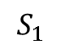
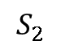

$$A=$$
. . .
$$S_{2}$$
$$S_{1}$$

Slide 2
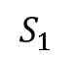
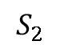

$$A=$$
$$S_{1}$$
. . .
$$S_{2}$$

Slide 3
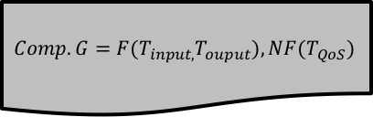
Step1
Step2
Step3
Step5
$$Comp.G={F(T}_{input,}T_{ouput}),NF(T_{QoS})$$
V
E
…
E
V
E
Select Relevant
Services
Composite
Service
E
V
V
E
V
…
E
V
E
Shrunken service repository
Swarm
E
V
…
V
E
Step4
S
S
S
…
S
S
S
Semantic Matchmaking
V
V
Best Location
E
V
…
E
E
Concept
Taxonomy
WSDL
+
MECE
Matchmaking
Semantic Aggregation
QoS
Aggregation
Swarm
S
S
S
…
S
S
S
Particle Swarm Optimization
Ontology
Service
Repository
Fitness
Function

Slide 4

Step1
Step2
Step3
Step5
$$Comp.T$$
V
E
…
E
V
E
Select Relevant
Services
Composite
Service
E
V
V
E
V
…
E
V
E
Shrunken service repository
Swarm
E
V
…
V
E
Step4
S
S
S
…
S
S
S
Semantic Matchmaking
I.
C
V
V
O.
E
V
…
E
E
Best Location
C
O.
C
O.
C
O.
C
Exact
Plugin1
Plugin2
Subs1
Concept
Taxonomy
WSDL
+
MECE
I.
C
Comprehensive Quality Model
Ontology-based Index Cache
Swarm
Semantic Matchmaking
O.
…
Particle Swarm Optimization
C
O.
C
O.
C
S
S
S
S
S
S
Ontology
Service
Repository
Exact
Plugin1
Plugin2
I.
C
Calculate Fitness
Function
O.
C
O.
C
O.
C
O.
C
Plugin1
Plugin2
Plugin3
Subs1

Slide 5
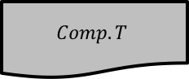
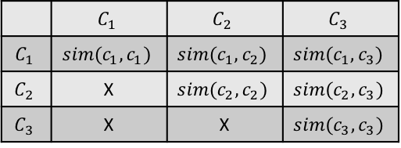
0.7 | 0.9 | 1 | … | 0.5 | 0.2 | 0.1
Step 1.
Composition Task
Step 2.
A greedy search and cache Initialisation
Step 3.
Particle Initialisation and Mapping
Step 4.
Particle evaluation and updating
$$Comp.T$$
Create service candidates queue
A swarm
S
S
S
…
S
S
S
A particle
Task-related
Service Candidates
…
0.3 0.2 1 … 0.6 0.4 0.9
A swarm
Update position
Service
Repository
A particle vectors
0.7 0.9 1 … 0.5 0.2 0.1
…
+
Sort service candidates queue
Calculate
Fitness
Particle Swarm Optimization ALG.1
+
Ontology-based Cache
…
S
S
S
S
S
S
Ontology
 | $$C_{1}$$ | $$C_{2}$$ | $$C_{3}$$
$$C_{1}$$ | $$sim(c_{1},c_{1})$$ | $$sim(c_{1},c_{2})$$ | $$sim(c_{1},c_{3})$$
$$C_{2}$$ | X | $$sim(c_{2},c_{2})$$ | $$sim(c_{2},c_{3})$$
$$C_{3}$$ | X | X | $$sim(c_{3},c_{3})$$
ALG.2
decoding
V
E
…
E
V
E
Comprehensive quality model
E
V
V
E
V
…
E
V
E

Slide 6
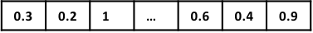
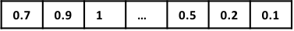
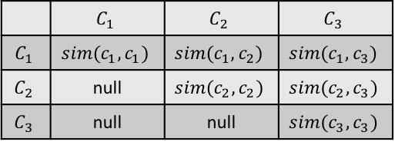
Step 1.
Composition Task
Step 2.
A greedy search and cache Initialisation
Step 3.
Particle Initialisation and Mapping
Step 4.
Particle evaluation and updating
$$Comp.T$$
Shrunken service repository
Create service candidates queue
A swarm
S
S
S
…
S
S
S
A particle position vectors
Task-related
Service Candidates
…
A swarm
Update position
Service
Repository
A particle position vectors
+
…
Sort service candidates queue
Calculate
Fitness
Particle Swarm Optimization ALG.1
+
Ontology-based Cache
…
S
S
S
S
S
S
Ontology
 | $$C_{1}$$ | $$C_{2}$$ | $$C_{3}$$
$$C_{1}$$ | $$sim(c_{1},c_{1})$$ | $$sim(c_{1},c_{2})$$ | $$sim(c_{1},c_{3})$$
$$C_{2}$$ | null | $$sim(c_{2},c_{2})$$ | $$sim(c_{2},c_{3})$$
$$C_{3}$$ | null | null | $$sim(c_{3},c_{3})$$
ALG.2
decoding
V
E
…
E
V
E
Comprehensive quality model
E
V
V
E
V
…
E
V
E

Slide 7
Web
Service
Output Parameter1
Output Individual1
Output Concept1
Parameter
matched
Yes
Matchmaking
Find Corresponding Individuals
Find Corresponding Concepts
Exist
Relationship
Web
Service
No
Input
Parameter1
Input Individual1
Input
Concept1
Fail
Service
Repository
WSDL
+
MECE
Concept
Taxonomy
Ontology

Slide 8
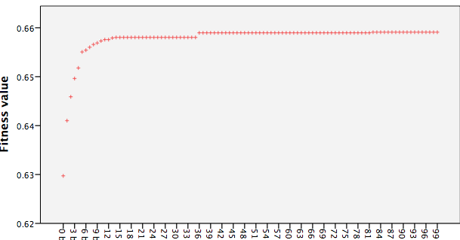
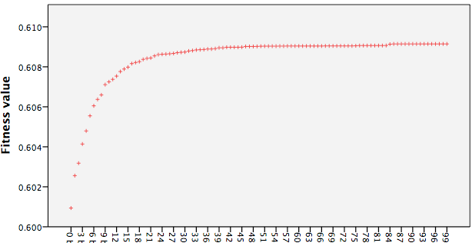
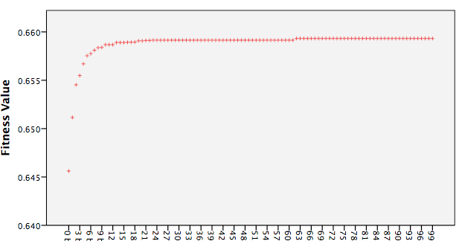
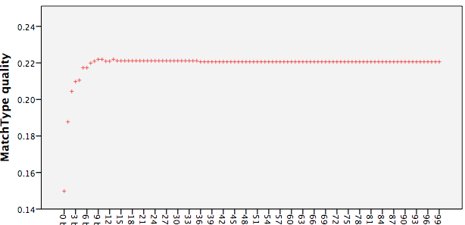
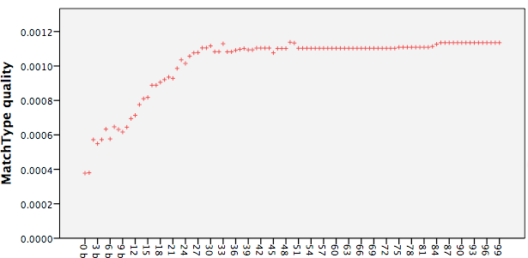
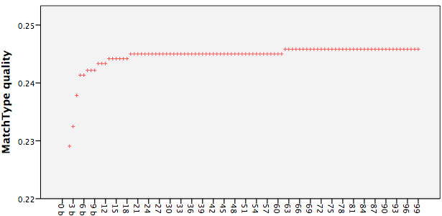
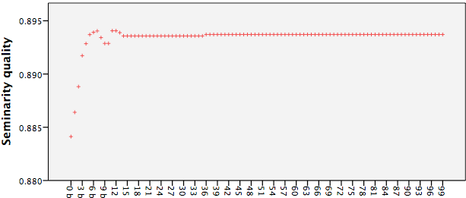
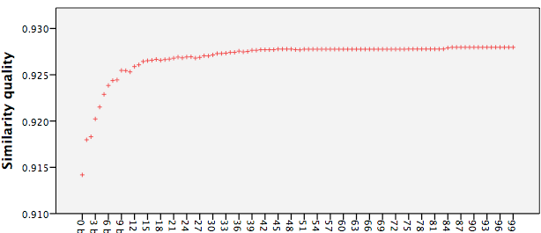
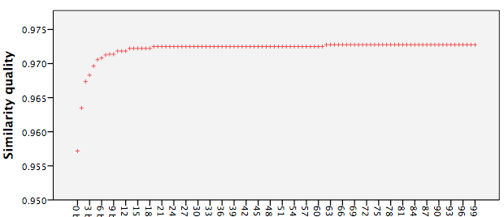
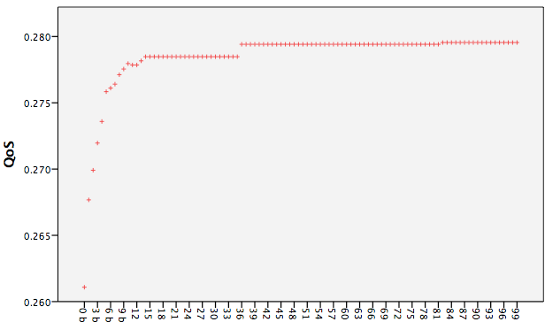
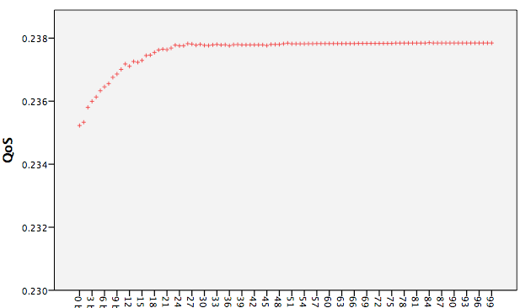
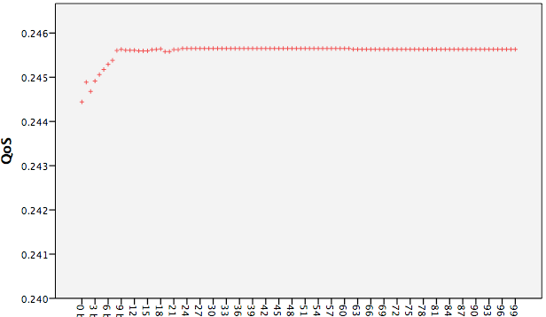
Task1
Task2
Task3

Slide 9
Task 1
Task 2
Task 3
Task 4
Task 5

Slide 10
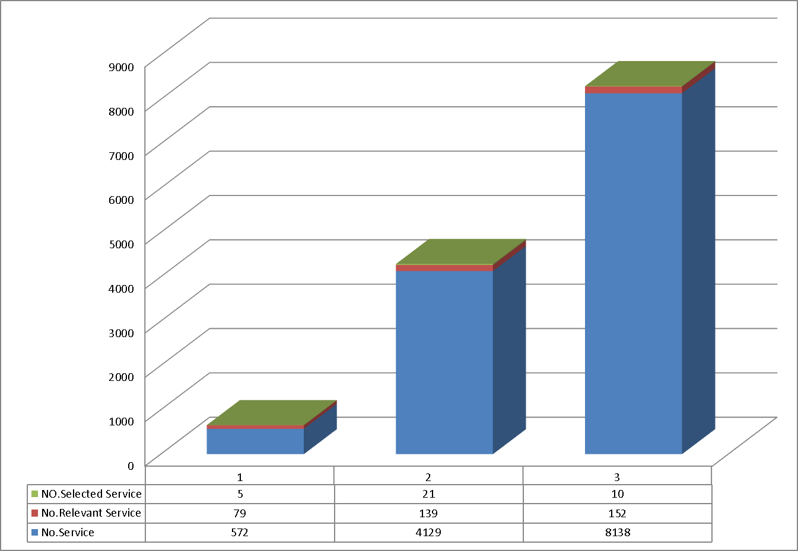
Problem1
Problem2
Problem3

Slide 11
Start
e1
serv129936728
e2
WG = (V, E)
V : ([startNode, serv129936728, serv1584736571, serv961485018, serv268801194, serv1723601037, endNode],
E: (e1, e2. e3. e4, e5, e6, e6, e7, e8, e9)
e1: (startNode, serv129936728) = 0.50; 0.82
e2: (serv129936728, serv1584736571) = 0.83; 0.94
e3: (serv1584736571, serv961485018) = 0.75; 0.95
e4: (serv961485018, serv268801194) = 0.50; 0.89
e5: (serv129936728, serv268801194) = 0.50; 0.83
e6: (serv268801194, serv1723601037) = 0.83; 0.94
e7: (serv1723601037, endNode) = 0.50; 0.85
e8: (serv129936728, endNode) = 1.00; 1.00
serv1584736571
e3
e5
serv961485018
e4
e8
serv268801194
e6
serv1723601037
e7
End

Slide 12
Start
e1
serv129936728
e2
serv1584736571
WSC = (V, E) Graph
V : ([startNode, serv129936728, serv1584736571, serv961485018, serv268801194, serv1723601037, endNode],
E: (e1, e2. e3. e4, e5, e6, e6, e7, e8, e9)
e1: (startNode,serv129936728) = 0.5;0.816117
e2: (serv129936728,serv1584736571) = 0.833333;0.944444
e3: (serv1584736571,serv961485018) = 0.75;0.949494
e4: (serv961485018,serv268801194) = 0.5;0.888888
e5: (serv129936728,serv268801194) = 0.5;0.833333
e6: (serv268801194,serv1723601037) = 0.833333;0.944444
e7: (serv1723601037,endNode) = 0.5;0.851851
e8: (serv129936728,endNode) = 1.0;1.0
e3
e5
serv961485018
e4
e8
serv268801194
e6
serv1723601037
e7
End

Slide 13
Start
e1
serv1779102626
serv1570805927
serv739257675
serv254870550
serv1086418840
serv2124625285
serv669825442
e2
serv878122141
e3
serv1016986607
serv947554374
e4
End
Start
e1
serv1779102626
serv1570805927
serv46573851
serv1086418840
serv2124625285
serv669825442
serv254870550
e2
serv185438317
e3
serv1016986607
serv1640238160
e4
End

Slide 14
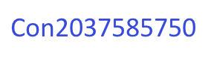
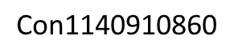
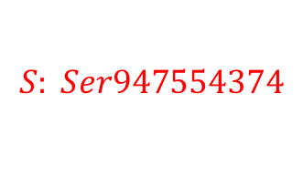
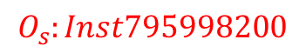
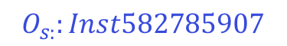
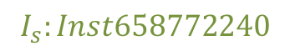
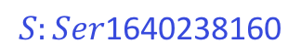

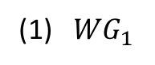
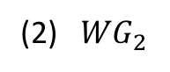
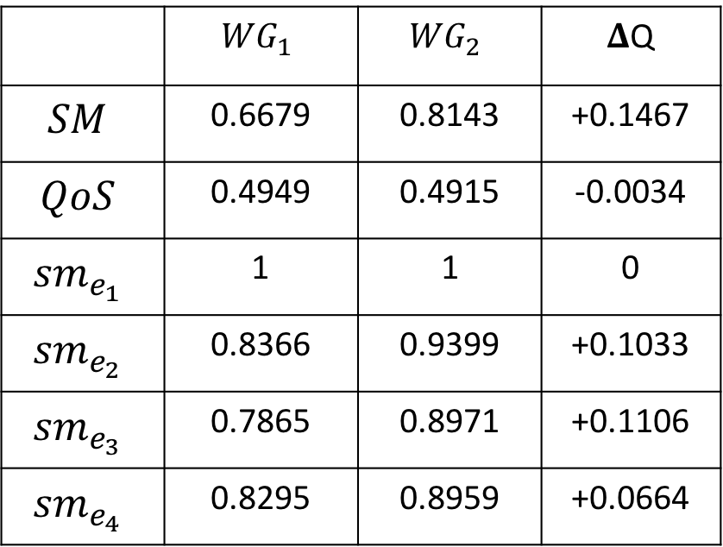

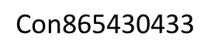
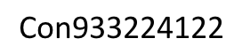
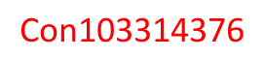
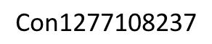
(1) ${WG}_{1}$
Start
(3)
 | $${WG}_{1}$$ | $${WG}_{2}$$ | 𝚫Q
$$SM$$ | 0.6679 | 0.8143 | +0.1467
$$QoS$$ | 0.4949 | 0.4915 | -0.0034
$${sm}_{e_{1}}$$ | 1 | 1 | 0
$${sm}_{e_{2}}$$ | 0.8366 | 0.9399 | +0.1033
$${sm}_{e_{3}}$$ | 0.7865 | 0.8971 | +0.1106
$${sm}_{e_{4}}$$ | 0.8295 | 0.8959 | +0.0664
e1
serv1779102626
serv1570805927
serv46573851
serv1086418840
serv2124625285
serv669825442
serv254870550
e2
serv185438317
e3
serv1016986607
serv1640238160
e4
End
$$\text{Con}\text{1140910860}$$
(2) ${WG}_{2}$
(4)
Start
e1
$$\text{Con}\text{2113572083}$$
serv1779102626
$$I_{s}:Inst658772240$$
serv1570805927
serv739257675
serv254870550
$$S:End$$
serv1086418840
serv2124625285
serv669825442
$$\text{Con}\text{865430433}$$
$$\text{Con}\text{933224122}$$
e2
serv878122141
$$\text{Con}\text{103314376}$$
$$\text{Con}\text{1277108237}$$
e3
serv1016986607
serv947554374
$$O_{s}:Inst795998200$$
$$S: Ser947554374$$
$\text{Con}\text{2}\text{037585}$750
e4
End
$$O_{s:}:Inst582785907$$
$$S:Ser\text{1640238160}$$

Slide 15
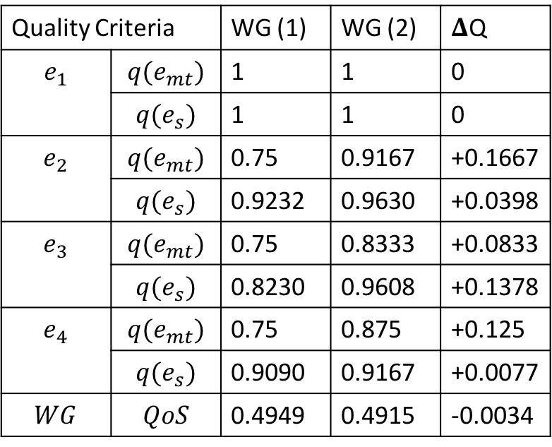
(1)
Start
(3)
e1
Quality Criteria |  | WG (1) | WG (2) | 𝚫Q
$$e_{1}$$ | $$q(e_{mt})$$ | 1 | 1 | 0
 | $$q(e_{s})$$ | 1 | 1 | 0
$$e_{2}$$ | $$q(e_{mt})$$ | 0.75 | 0.9167 | +0.1667
 | $$q(e_{s})$$ | 0.9232 | 0.9630 | +0.0398
$$e_{3}$$ | $$q(e_{mt})$$ | 0.75 | 0.8333 | +0.0833
 | $$q(e_{s})$$ | 0.8230 | 0.9608 | +0.1378
$$e_{4}$$ | $$q(e_{mt})$$ | 0.75 | 0.875 | +0.125
 | $$q(e_{s})$$ | 0.9090 | 0.9167 | +0.0077
$$WG$$ | $$QoS$$ | 0.4949 | 0.4915 | -0.0034
serv1779102626
serv1570805927
serv46573851
serv1086418840
serv2124625285
serv669825442
serv254870550
e2
serv185438317
e3
serv1016986607
serv1640238160
e4
End
(2)
Start
e1
serv1779102626
serv1570805927
serv739257675
serv254870550
serv1086418840
serv2124625285
serv669825442
e2
serv878122141
e3
serv1016986607
serv947554374
e4
End

Slide 16
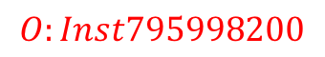
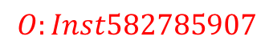
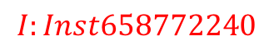
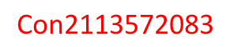
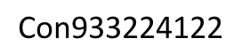
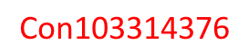
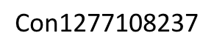
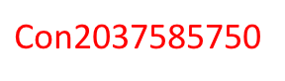
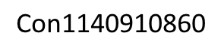
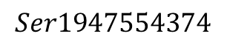
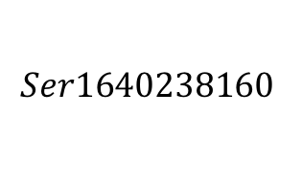
$$\text{Con}\text{1140910860}$$
$$\text{Con}\text{2113572083}$$
$$I:Inst658772240$$
$$\text{Con}\text{865430433}$$
$$\text{Con}\text{933224122}$$
$$\text{Con}\text{103314376}$$
$$\text{Con}\text{1277108237}$$
$$O:Inst795998200$$
$$Ser1640238160$$
$\text{Con}\text{2}\text{037585}$750
$$O:Inst582785907$$
$$Ser1947554374$$

Slide 17
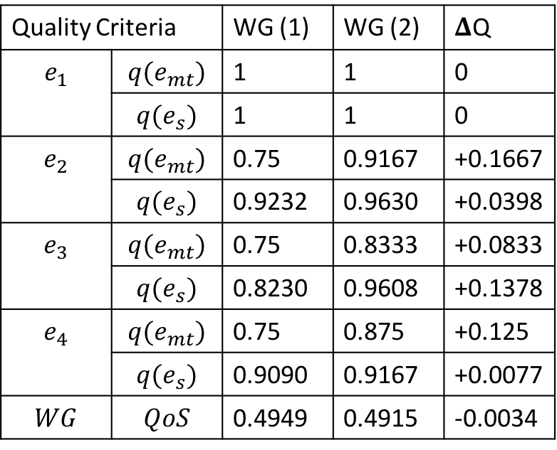
% Please add the following required packages to your document preamble:% \usepackage{multirow}\begin{table}[]\centering\caption{Comparison of Composition Weighted Graphs}\label{comparisontaxonomy}\begin{tabular}{l|l|l|l|l}\hline\multicolumn{2}{l|}{\shortstack{Quality \\ Criteria}} & WG $(1)$ & WG $(2)$ & $\Delta Q$\\ \hline\multirow{2}{*}{e1} &$q(e_{mt})$ &1 &1 &0 \\ \cline{2-5} & $q(e_{s})$ &1 &1 &0\\ \hline\multirow{2}{*}{e2} & $q(e_{mt})$ &0.75 &0.9167 &+0.1667 \\ \cline{2-5} & $q(e_{s})$ &0.9232 &0.9630 &+0.0398\\ \hline\multirow{2}{*}{e3} & $q(e_{mt})$ &0.75 &0.8333 &+0.08333\\ \cline{2-5} & $q(e_{s})$ &0.8230 &0.9608 &+0.1378\\ \hline\multirow{2}{*}{e4} & $q(e_{mt})$ &0.75 &0.875 &+0.125\\ \cline{2-5} & $q(e_{s})$ &0.9090 &0.9167 &+0.0077\\ \hline\multicolumn{2}{l|}{WG QoS} &0.4949 &0.4915 &-0.0034 \\ \hline\end{tabular}\end{table}
Quality Criteria |  | WG (1) | WG (2) | 𝚫Q
$$e_{1}$$ | $$q(e_{mt})$$ | 1 | 1 | 0
 | $$q(e_{s})$$ | 1 | 1 | 0
$$e_{2}$$ | $$q(e_{mt})$$ | 0.75 | 0.9167 | +0.1667
 | $$q(e_{s})$$ | 0.9232 | 0.9630 | +0.0398
$$e_{3}$$ | $$q(e_{mt})$$ | 0.75 | 0.8333 | +0.0833
 | $$q(e_{s})$$ | 0.8230 | 0.9608 | +0.1378
$$e_{4}$$ | $$q(e_{mt})$$ | 0.75 | 0.875 | +0.125
 | $$q(e_{s})$$ | 0.9090 | 0.9167 | +0.0077
$$WG$$ | $$QoS$$ | 0.4949 | 0.4915 | -0.0034

Slide 18










(1)
Start
e1
serv1779102626
serv1570805927
serv46573851
serv1086418840
serv2124625285
serv669825442
serv254870550
e2
serv185438317
e3
serv1016986607
serv1640238160
e4
End
(2)
Start
e1
serv1779102626
serv1570805927
serv739257675
serv254870550
serv1086418840
serv2124625285
serv669825442
e2
serv878122141
e3
serv1016986607
serv947554374
e4
(3)
End
$$\text{Con}\text{1140910860}$$
$$\text{Con}\text{2113572083}$$
$$I:Inst658772240$$
$$\text{Con}\text{865430433}$$
$$\text{Con}\text{933224122}$$
$$\text{Con}\text{103314376}$$
$$\text{Con}\text{1277108237}$$
$$O:Inst795998200$$
$$Ser1640238160$$
$\text{Con}\text{2}\text{037585}$750
$$O:Inst582785907$$
$$Ser1947554374$$

Slide 22














$$I_{1S_{1}}$$
$$O_{1S_{1}}$$
$$I_{1S_{2}}$$
$$O_{1S_{2}}$$
$$S_{1}$$
$$S_{2}$$
$$I_{2S_{1}}$$
$$O_{2S_{1}}$$
$$I_{2S_{2}}$$
$$O_{2S_{2}}$$
$$I_{3S_{2}}$$
$${sm}_{L}$$
$${sm}_{P}$$
$$O_{3S_{1}}$$
Semantic web service link
Parameter matchmaking

Slide 23
Hotel Function
Availability = "0.69"
Price = "2.29"
Reliability = "0.46"
Response = "670.94"
TravelReturnDate I: HotelCheckoutDate
O:FlightArrivalDate I:HotelCheckinDate
O: HotelReservation I: HotelReservation
Flight Information
Availability = "0.64"
Price = "3.47"
Reliability = "0.45"
Response = "757.93"
O: HomeCity I: FlightOriginCity
O: ConferenceCity I: FlightDestinationCity
O: TravelDepartureDate I: FlightDepartureDate
O: TravelReturnDate I: FlightReturnDate
Start
O: FlightTicket I:FlightTicket
End
O: FlightArrivalDate I:BusDepartureDate
O:BusTicket I : BusTicket
ConferenceCity I: BusDestinationCity
Task Input: TravelDepartureDate, HomeCity, ConferenceCity, TravelReturnDate
Bus Service
Availability = "0.07"
Price = "1.15"
Price = "0.72"
Response = "429.23"
Task Output:
BusTicket,
FlightTicket,
TouristMap, HotelReservation
ConferenceCity I: MappedLocation
O:StreetMap I:TouristMap
Generate Map
Availability ="0.46"
Price ="6.72"
Reliability ="0.66"
Response ="174.47"

Slide 24
Hotel Function
Availability = "0.69"
Price = "2.29"
Reliability = "0.46"
Response = "670.94"
O:TravelReturnDate I: HotelCheckoutDate
O:FlightArrivalDate
I:HotelCheckinDate
O: HotelReservation
I: HotelReservation
Flight Information
Availability = "0.64"
Price = "3.47"
Reliability = "0.45"
Response = "757.93"
O: HomeCity I: FlightOriginCity
O: ConferenceCity I: FlightDestinationCity
O: TravelDepartureDate I: FlightDepartureDate
O: TravelReturnDate I: FlightReturnDate
Start
O: FlightTicket
I: FlightTicket
End
O: FlightArrivalDate
I: BusDepartureDate
Task Output:
BusTicket,
FlightTicket,
TouristMap, HotelReservation
O: ConferenceCity
I: BusDestinationCity
O:BusTicket
I : BusTicket
Task Input: TravelDepartureDate, HomeCity, ConferenceCity, TravelReturnDate
Bus Service
Availability = "0.07"
Price = "1.15"
Price = "0.72"
Response = "429.23"
O: ConferenceCity
I: MappedLocation
O: StreetMap
I: TouristMap
Generate Map
Availability ="0.46"
Price ="6.72"
Reliability ="0.66"
Response ="174.47"

Slide 25
OWL: Thing
Travel Information
FlightReturnDate
HotelCheckoutDate
TravelReturnDate
Date
Location
Map
Reservation
Ticket
MappedLocation
TouristMap
HotelReservation
Departure Date
Arrival Date
City
Rural Map
Urban Map
Bus Ticket
AirplaneTicket
FarmMap
StreetMap
BusTicket
FlightTicket
FlightDepartureDate
TravelDepartureDate
FlightArrivalDate
HotelCheckinDate
BusDepartureDate
From City
To City
FlightOriginCity
HomeCity
BusDestinationCity
ConferenceCity
FlightDestinationCity
Concept:
Instance:

Slide 26
Hotel Function
Availability = ”1.00"
Price = ”3.50"
Reliability = ”0.99"
Response = ”700.00"
O:TravelReturnDate I: HotelCheckoutDate
O:FlightArrivalDate
I:HotelCheckinDate
O: HotelReservation
I: HotelReservation
Flight Information
Availability = "0.90"
Price = ”3.00"
Reliability = ”0.95"
Response = ”500.00"
O: HomeCity I: FlightOriginCity
O: ConferenceCity I: FlightDestinationCity
O: TravelDepartureDate I: FlightDepartureDate
O: TravelReturnDate I: FlightReturnDate
Start
O: FlightTicket
I: FlightTicket
End
O: FlightArrivalDate
I: BusDepartureDate
Task Output:
BusTicket,
FlightTicket,
TouristMap, HotelReservation
O: ConferenceCity
I: BusDestinationCity
O:BusTicket
I : BusTicket
Task Input: TravelDepartureDate, HomeCity, ConferenceCity, TravelReturnDate
Bus Service
Availability = "0.80"
Price = ”5.00"
Reliability = ”0.80"
Response = ”400.00"
O: ConferenceCity
I: MappedLocation
O: StreetMap
I: TouristMap
Generate Map
Availability =”0.70"
Price =”9.00"
Reliability =”1.00"
Response =”200.00"

